Slide 1

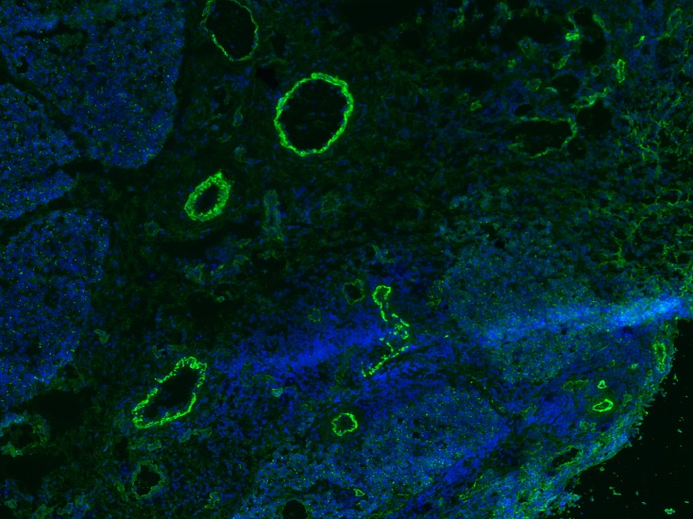
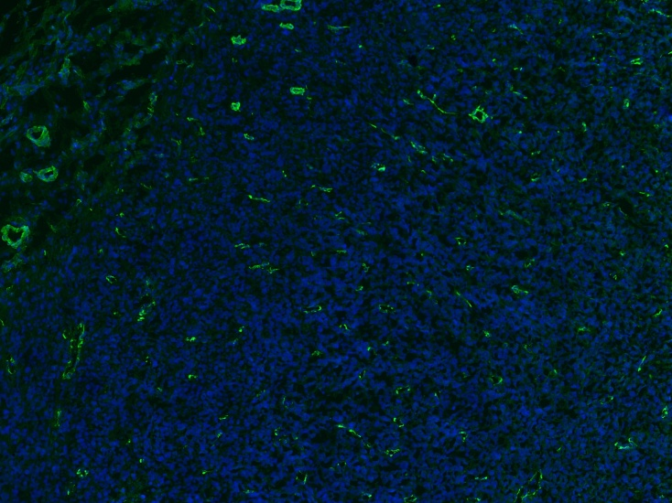
ReliaTech GmbH
IHC with mouse anti-human/rat VEGF-C #9E7
(Cat# 101-M90)
Staining of VEGF-C on cryo sections (acetone-fixed) of rat mammary tumors.
MT450, primary tumor
NM081, primary tumor
Anti-human VEGF-C #9E7.
The experiment was performed by Natascha Cremers, Universitätsmedizin Mannheim
Centre for Biomedicine and Medical Technology Mannheim (CBTM)
D-68167 Mannheim, Germany
http://www.reliatech.de / orders@reliatech.de

Slide 2
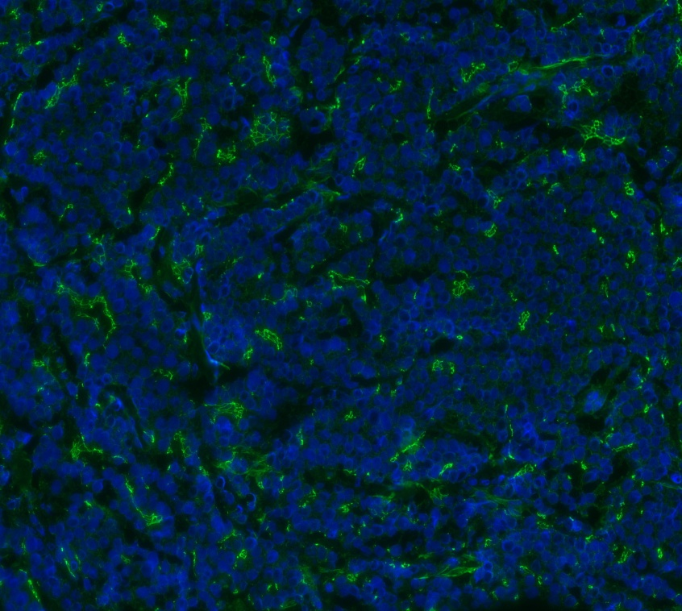
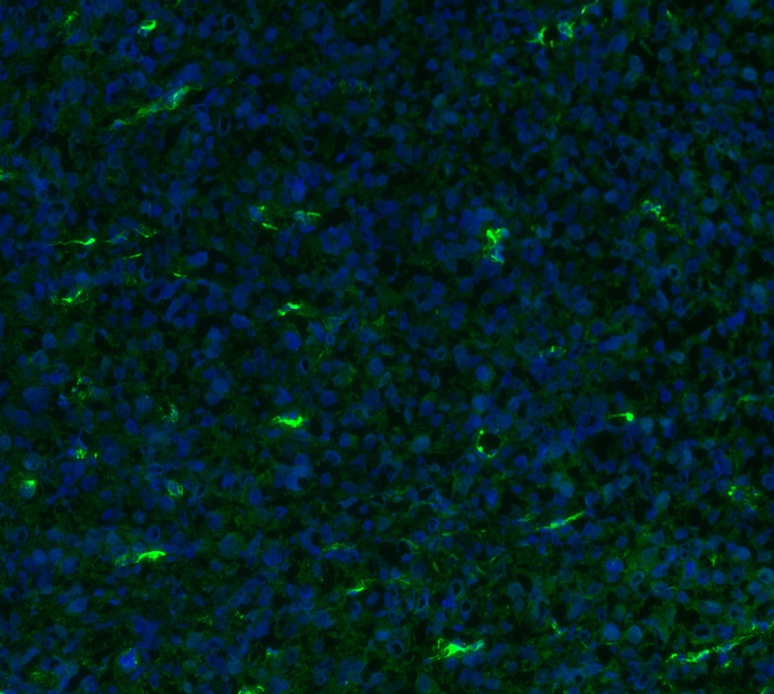
RELIATech GmbH
IHC with anti-human/rat VEGF-C #9E7
(mouse mab; RELIATech Cat# 101-M90)
Staining of VEGF-C on cryo sections (unfixed) of rat mammary tumors.
MT450, primary tumor
NM081, primary tumor
Anti-human VEGF-C #9E7.
The experiment was performed by Natascha Cremers, Universitätsmedizin Mannheim
Centre for Biomedicine and Medical Technology Mannheim (CBTM)
D-68167 Mannheim, Germany
http://www.reliatech.de / info@reliatech.de
Notes:
2

Slide 3
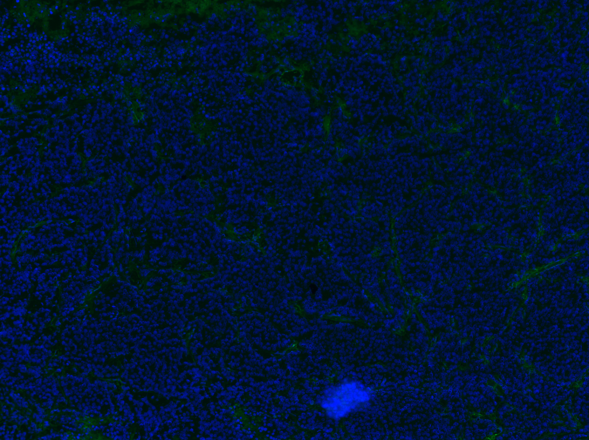
RELIATech GmbH
Secondary ab control
http://www.reliatech.de / info@reliatech.de

